Slide 1
Current IDE Algorithm
Gene Yang

Slide 2
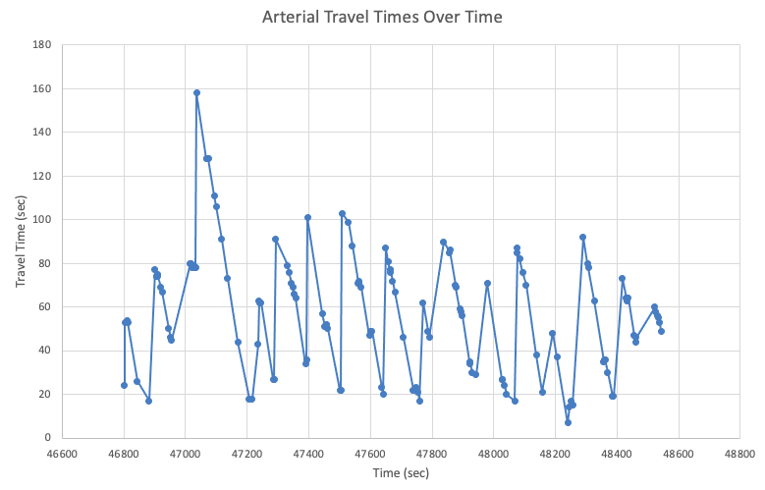
The Data

Slide 3
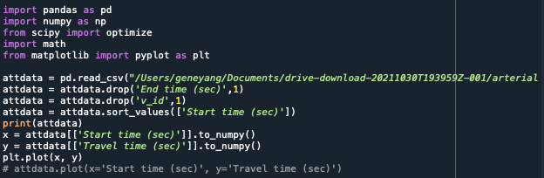
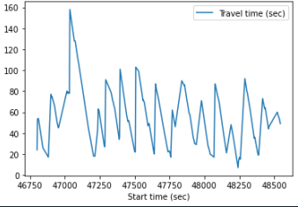
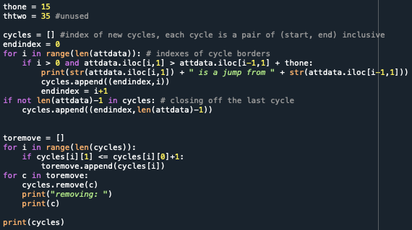
Setup/Data Etraction

Slide 4
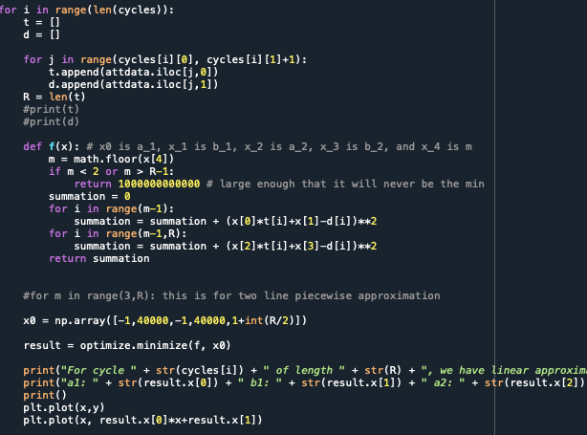
The Main Loop

Slide 5
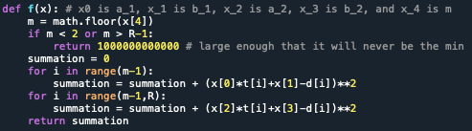
Function to optimize
Here f(x) takes in a five-dimensional vector, with x[0] representing a_1, x[1] b_1, etc., as the comment says.
If m is out of the range specified in the paper, for now the loop just returns a really large number, but small cycles need special attention.
Then this creates the summation for f(x). Later, the code will minimize this function.

Slide 6
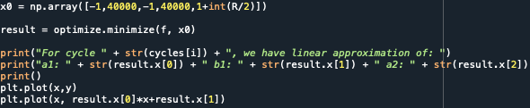
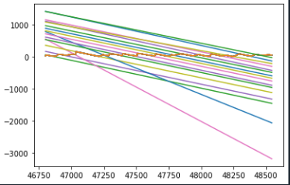
Getting Results
Sets an initial guess with reasonable values – unsure how much this impacts, as the results have quite a few with values of just 40000 or 40000.00003 for x[1] and x[3].
Again, sometimes breaks when R (the cycle size) is too small.
Uses the optimize.minimize function from scipy
Could also add constraints (the required equality) and bounds, unsuccessfully tried in the other broken version
Then prints out the solutions and plots them – unsure of a more useful way to represent the data as of now, and the plotting gets skewed by a single outlier and is essentially useless for manual verification purposes.
The graph is now correct, with the red line being the data. Again, the graph needs to bound each line for it to be useful.

Slide 7
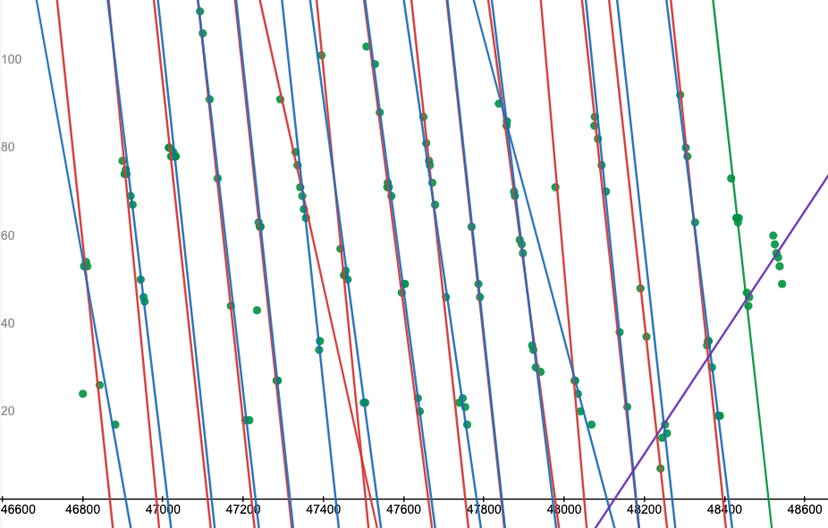
Seeing Results
Fit lines when graphed alongside data
An example output (done for each cycle)

Slide 8

Current Problems
There is an outlier:
Fails in general with really
short cycles (m<=3)
Some of the results are suspicious turned out to be correct
b1 and b2 are both very close to 40000 but the linear equation works so maybe the data is very coincidental
The last line segment goes upwards as you can see in the graph or here:
Note that we see a2 is positive

Slide 9

Next Steps
The lines don’t yet have the requirement to intersect between t_m-1 and t_m
I tried adding the distance between their intersection and being between t_m-1 and t_m into the cost f(x) function, but it wasn’t very useful. I think the optimize’s constraint function will be useful
If not, can solve for theta ( ), and require it to be between 0 and 1
There are always two lines, I implemented the one-line way separately and need to do the threshold and comparisons to choose one line or two
Here, again, I’d need to figure out a better way to store the information about the linear approximations, since storing two linear equations is different than storing one and I’d need to do both at different times
No cycle length adjustment or anything

